Slide 1
OSI Physical Layer
Network Fundamentals – Chapter 8

Slide 2
Objectives
Explain the role of Physical layer protocols and services in supporting communication across data networks.
  - Describe the role of signals used to represent bits as a frame as the frame is transported across the local media
Describe the purpose of Physical layer signaling and encoding as they are used in networks
Identify the basic characteristics of copper, fiber and wireless network media
Describe common uses of copper, fiber and wireless network media

Slide 3
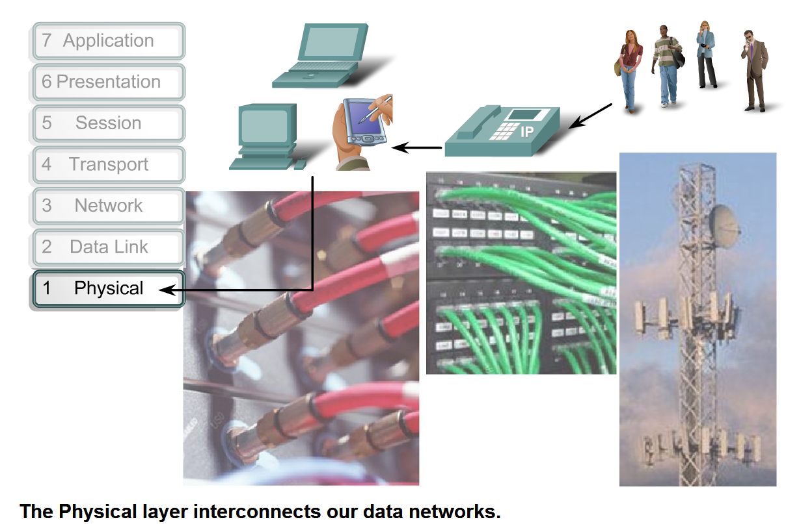
Physical Layer Protocols & Services
Describe the purpose of the Physical layer in the network and identify the basic elements that enable this layer to fulfill its function

Slide 4
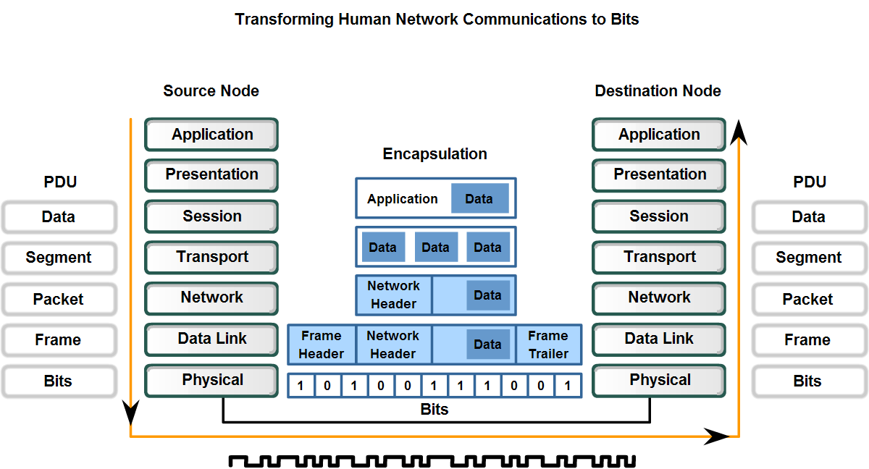
Physical Layer Protocols & Services
Describe the role of bits in representing a frame as it is transported across the local media.

Slide 5
Physical Layer Characteristics
The OSI Physical layer provides the means to transport across the network media the bits that make up a Data Link layer frame.
This layer accepts a complete frame from the Data Link layer and encodes it as a series of signals that are transmitted onto the local media.
The encoded bits that comprise a frame are received by either an end device or an intermediate device.
The delivery of frames across the local media requires the following Physical layer elements:
The physical media and associated connectors
A representation of bits on the media
Encoding of data and control information
Transmitter and receiver circuitry on the network devices

Slide 6
Physical Layer Purpose
At this stage of the communication process, the user data has been segmented by the Transport layer, placed into packets by the Network layer, and further encapsulated as frames by the Data Link layer.
The purpose of the Physical layer is to create the electrical, optical, or microwave signal that represents the bits in each frame.
These signals are then sent on the media one at a time.
It is also the job of the Physical layer to retrieve these individual signals from the media, restore them to their bit representations, and pass the bits up to the Data Link layer as a complete frame.

Slide 7
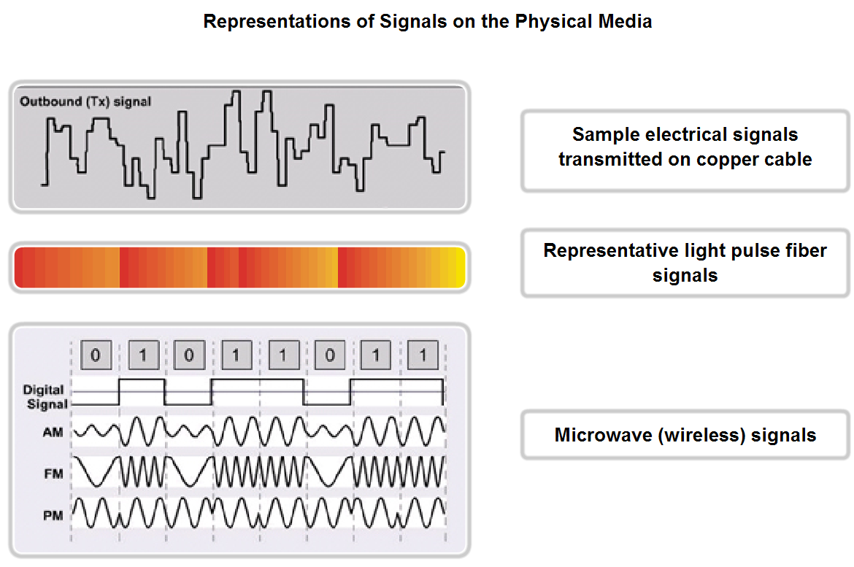
Physical Layer Protocols & Services
Describe the role of signaling in the physical media.

Slide 8
Operation
The media does not carry the frame as a single entity. The media carries signals, one at a time, to represent the bits that make up the frame.
There are three basic forms of network media on which data is represented:
Copper cable
Fiber
Wireless
The representation of the bits - that is, the type of signal - depends on the type of media. For copper cable media, the signals are patterns of electrical pulses.
For fiber, the signals are patterns of light. For wireless media, the signals are patterns of radio transmissions.

Slide 9
Frame Identification
When the Physical layer encodes the bits into the signals for a particular medium, it must also distinguish where one frame ends and the next frame begins.
Otherwise, the devices on the media would not recognize when a frame has been fully received.
In that case, the destination device would only receive a string of signals and would not be able to properly reconstruct the frame.
To enable a receiving device to clearly recognize a frame boundary, the transmitting device adds signals to designate the start and end of a frame.
These signals represent particular bit patterns that are only used to denote the start or end of a frame.

Slide 10
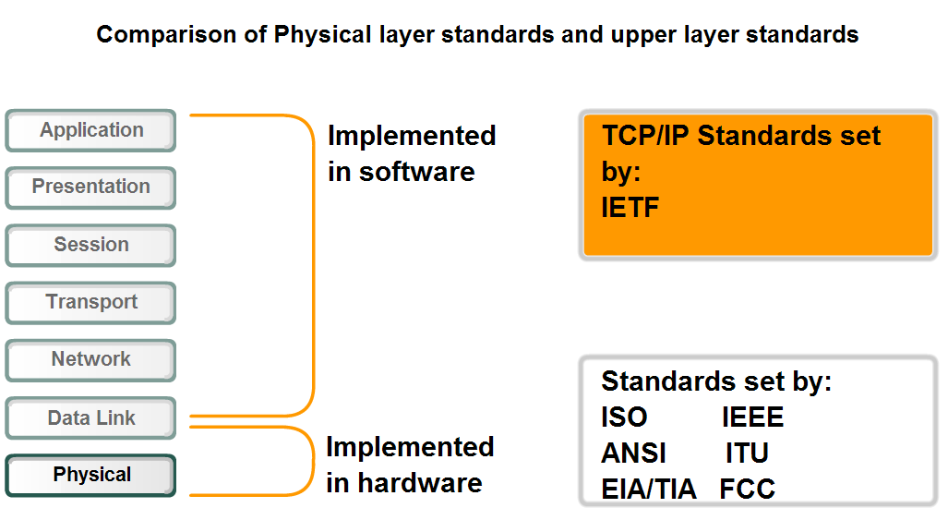
Physical Layer Protocols & Services
Distinguish who establishes and maintains standards for the Physical layers compared to those for the other layers of the network

Slide 11
Physical Layer Standards
Similar to technologies associated with the Data Link layer, the Physical layer technologies are defined by organizations such as:
The International Organization for Standardization (ISO)
The Institute of Electrical and Electronics Engineers (IEEE)
The American National Standards Institute (ANSI)
The International Telecommunication Union (ITU)
The Electronics Industry Alliance/Telecommunications Industry Association (EIA/TIA)
National telecommunications authorities such as the Federal Communication Commission (FCC) in the USA.

Slide 12
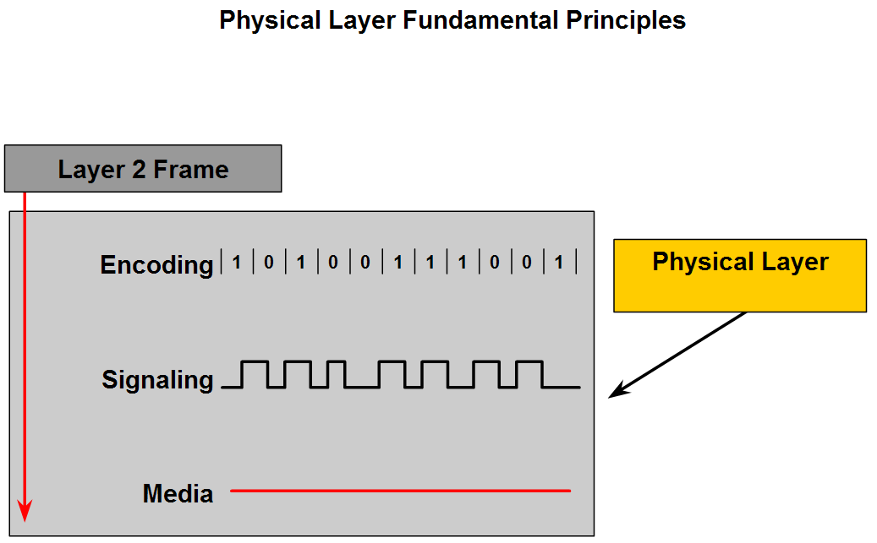
Physical Layer Protocols & Services
Identify hardware components associated with the Physical layer that are governed by standards

Slide 13
Encoding
Encoding is a method of converting a stream of data bits into a predefined code.
Codes are groupings of bits used to provide a predictable pattern that can be recognized by both the sender and the received.
Using predictable patterns helps to distinguish data bits from control bits and provide better media error detection.
In addition to creating codes for data, encoding methods at the Physical layer may also provide codes for control purposes such as identifying the beginning and end of a frame.
The transmitting host will transmit the specific pattern of bits or a code to identify the beginning and end of the frame.

Slide 14
Signalling
The Physical layer must generate the electrical, optical, or wireless signals that represent the "1" and "0" on the media.
The method of representing the bits is called the signalling method.
The Physical layer standards must define what type of signal represents a "1" and a "0".
This can be as simple as a change in the level of an electrical signal or optical pulse or a more complex signalling method.
The Physical layer represents each of the bits in the frame as a signal.
Each signal placed onto the media has a specific amount of time to occupy the media.
This is referred to as its bit time. Signals are processed by the receiving device and returned to its representation as bits.

Slide 15
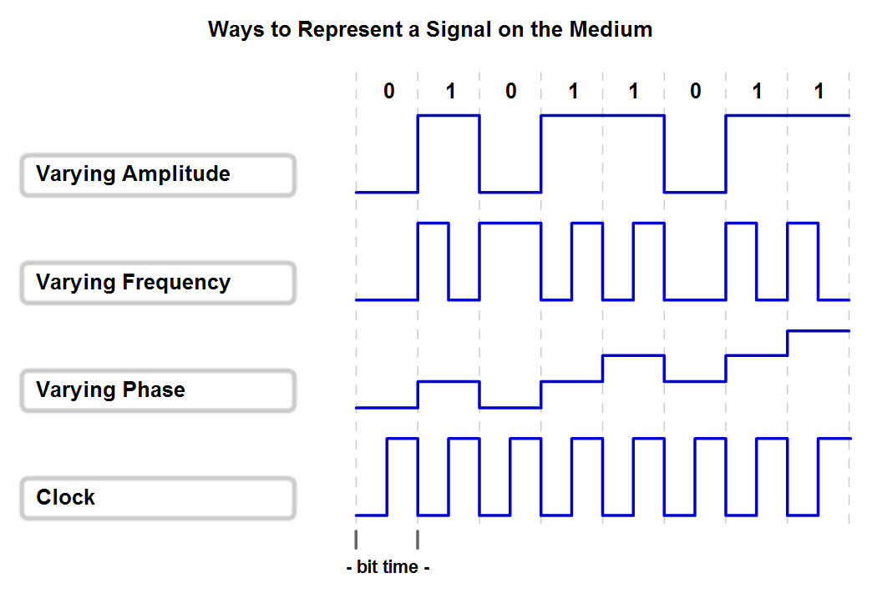
Physical Layer Signaling and Encoding
Explain that network communication at this layer consists of individual bits encoded onto the Physical layer and describe the basic encoding techniques.

Slide 16
Signalling Methods
Bits are represented on the medium by changing one or more of the following characteristics of a signal:
Amplitude
Frequency
Phase (position of a point in time (instant) on a waveform cycle)
The nature of the actual signals representing the bits on the media will depend on the signalling method in use. Some methods may use one attribute of signal to represent a single 0 and use another attribute of signal to represent a single 1.
As an example, with Non-Return to Zero (NRZ), a 0 may be represented by one voltage level on the media during the bit time and a 1 might be represented by a different voltage on the media during the bit time.

Slide 17
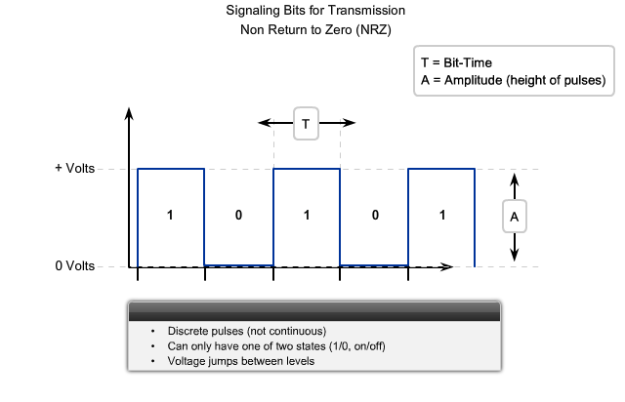
NRZ-Signalling

Slide 18
NRZ contd..
A low voltage value represents a logical 0 and a high voltage value represents a logical 1. The voltage range depends on the particular Physical layer standard in use.
This simple method of signalling is only suited for slow speed data links. NRZ signalling uses bandwidth inefficiently and is susceptible to electromagnetic interference.
Additionally, the boundaries between individual bits can be lost when long strings of 1s or 0s are transmitted consecutively.
In that case, no voltage transitions are detectable on the media. Therefore, the receiving nodes do not have a transition to use in resynchronizing bit times with the transmitting node.

Slide 19
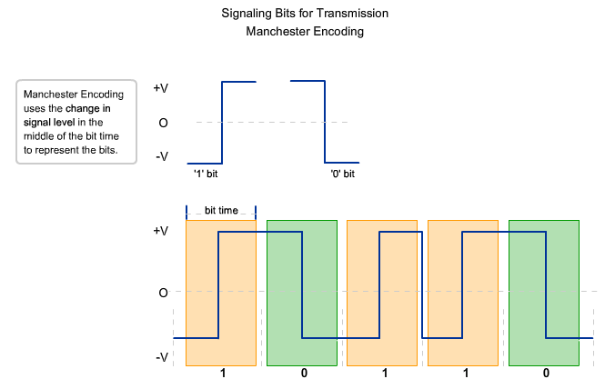
Manchester Encoding

Slide 20
Manchester Encoding
Instead of representing bits as pulses of simple voltage values, in the Manchester Encoding scheme, bit values are represented as voltage transitions.
This transition can be used to ensure that the bit times in the receiving nodes are synchronized with the transmitting node
The transition in the middle of the bit time will be either the up or down direction for each unit of time in which a bit is transmitted.
For consecutive bit values, a transition on the bit boundary "sets up" the appropriate mid-bit time transition that represents the bit value.
Although Manchester Encoding is not efficient enough to be used at higher signalling speeds, it is the signalling method employed by 10BaseT Ethernet (Ethernet running at 10 Megabits per second).
http://www.wildpackets.com/resources/compendium/fast_ethernet/signal_4b5b

Slide 21
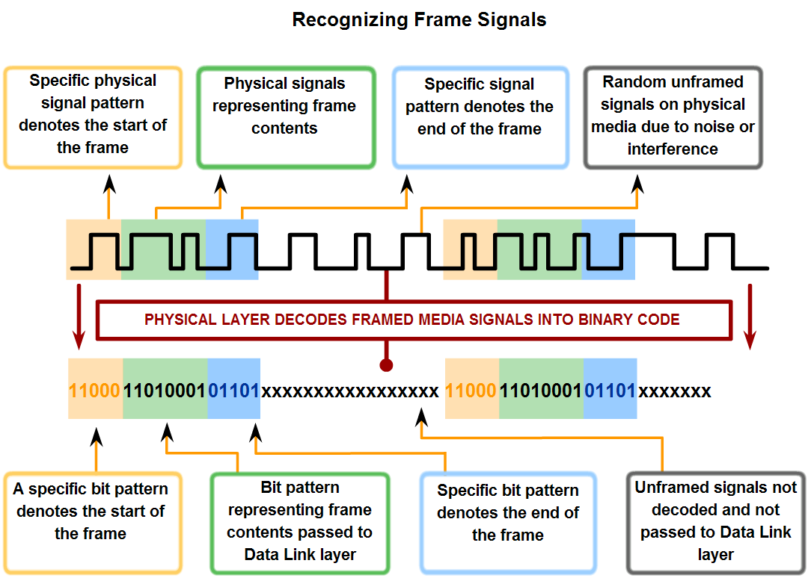
Physical Layer Signaling and Encoding
Describe the role of encoding as it applies to the transmission of bits and explain the value of treating a collection of bits as a code.

Slide 22
Why use Encoding?
We use of the word encoding to represent the symbolic grouping of bits prior to being presented to the media.
By using an encoding step before the signals are placed on the media, we improve the efficiency at higher speed data transmission.
As we use higher speeds on the media, we have the possibility that data will be corrupted.
By using the coding groups, we can detect errors more efficiently.
Additionally, as the demand for data speeds increase, we seek ways to represent more data across the media, by transmitting fewer bits.
Coding groups provide a method of making this data representation.

Slide 23
Signal Patterns
One way to provide frame detection is to begin each frame with a pattern of signals representing bits that the
Physical layer recognizes as denoting the start of a frame. Another pattern of bits will signal the end of the frame.
Signal bits not framed in this manner are ignored by the Physical layer standard being used.
Valid data bits need to be grouped into a frame; otherwise, data bits will be received without any context to give them meaning to the upper layers of the networking model
Signal patterns can indicate: start of frame, end of frame, and frame contents.
These signal patterns can be decoded into bits. The bits are interpreted as codes. The codes indicate where the frames start and stop.

Slide 24
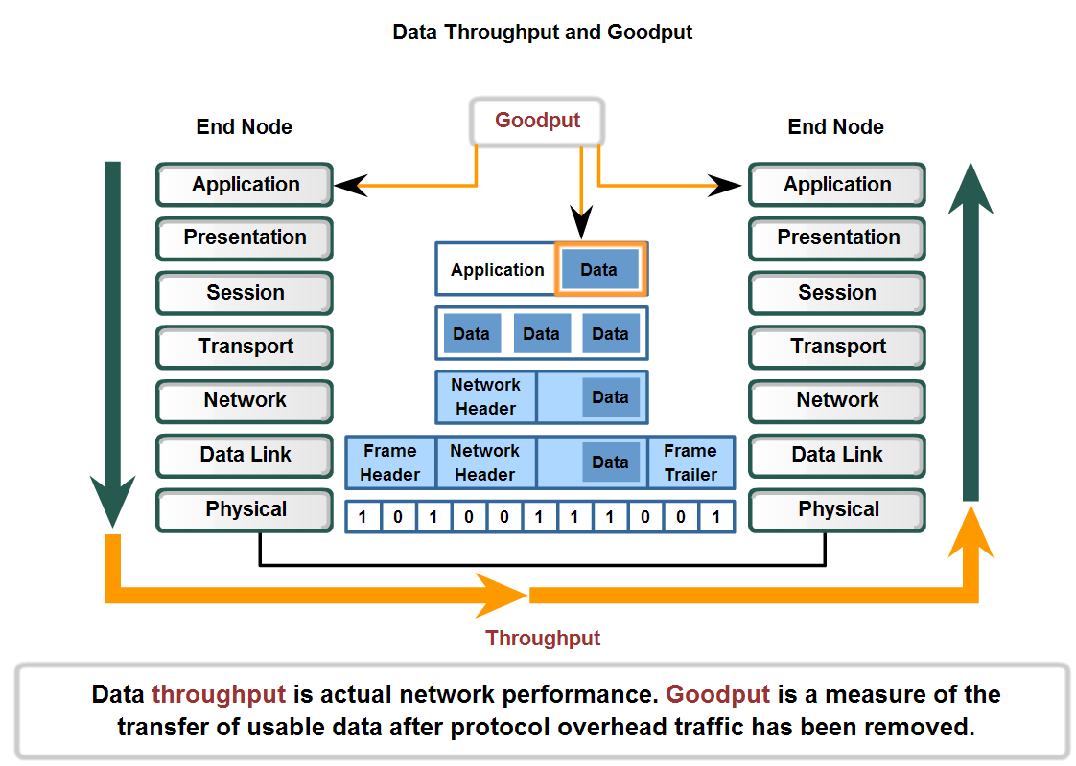
Physical Layer Signaling and Encoding
Define the terms bandwidth, throughput, and goodput

Slide 25
Bandwidth
The capacity of a medium to carry data is described as the raw data bandwidth of the media.
Digital bandwidth measures the amount of information that can flow from one place to another in a given amount of time.
Bandwidth is typically measured in kilobits per second (kbps) or megabits per second (Mbps).
The practical bandwidth of a network is determined by a combination of factors: the properties of the physical media and the technologies chosen for signalling and detecting network signals.
Physical media properties, current technologies, and the laws of physics all play a role in determining available bandwidth.

Slide 26
Throughput
Throughput is the measure of the transfer of bits across the media over a given period of time.
Due to a number of factors, throughput usually does not match the specified bandwidth in Physical layer implementations such as Ethernet.
Many factors influence throughput.
Among these factors are the amount of traffic, the type of traffic, and the number of network devices encountered on the network being measured. In a multi-access topology such as Ethernet, nodes are competing for media access and its use.
Therefore, the throughput of each node is degraded as usage of the media increases.
In an internetwork or network with multiple segments, throughput cannot be faster than the slowest link of the path from source to destination.
Even if all or most of the segments have high bandwidth, it will only take one segment in the path with low throughput to create a bottleneck to the throughput of the entire network.

Slide 27
Goodput
A third measurement has been created to measure the transfer of usable data.
That measure is known as goodput.
Goodput is the measure of usable data transferred over a given period of time, and is therefore the measure that is of most interest to network users.
Unlike throughput, which measures the transfer of bits and not the transfer of usable data, goodput accounts for bits devoted to protocol overhead.
Goodput is throughput minus traffic overhead for establishing sessions, acknowledgements, and encapsulation.

Slide 28
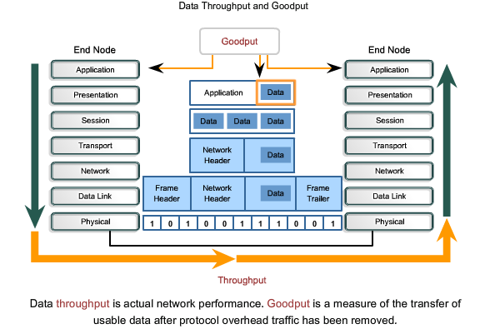
Throughput and Goodput

Slide 29
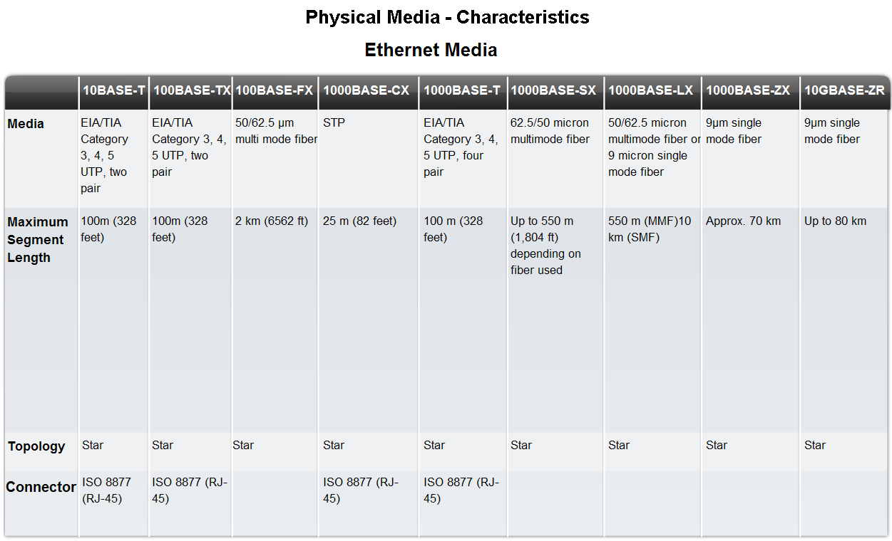
Characteristics & Uses of Network Media
Identify several media characteristics defined by Physical layer standards.

Slide 30
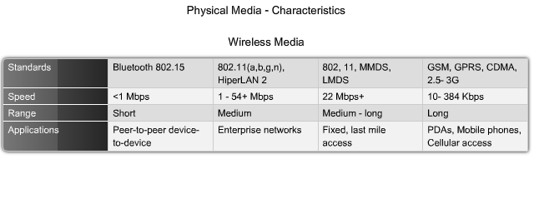
Wireless Media Characteristics

Slide 31
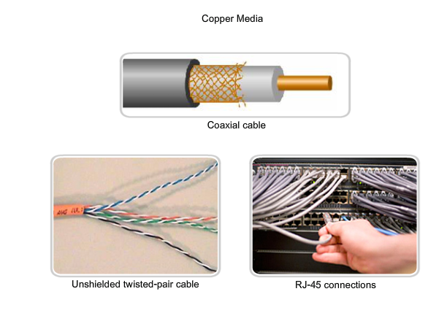
Copper Media

Slide 32
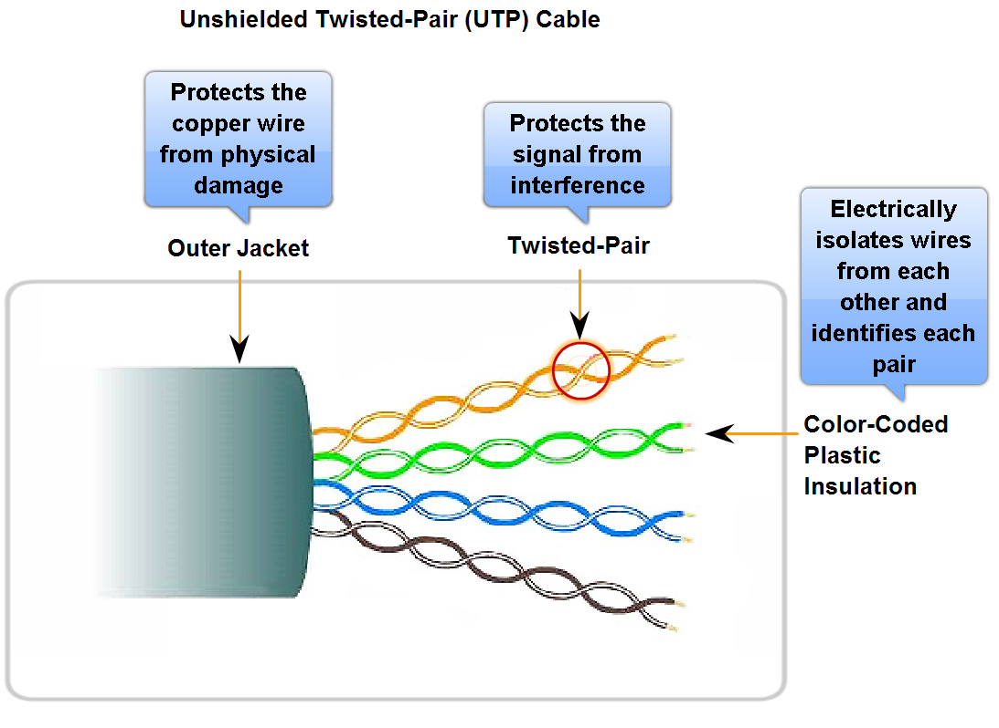
Characteristics & Uses of Network Media
Identify the basic characteristics of UTP cable

Slide 33
Cabling Standards
The UTP cabling commonly found in workplaces, schools, and homes conforms to the standards established jointly by the Telecommunications Industry Association (TIA) and the Electronics Industries Alliance (EIA).
TIA/EIA-568A stipulates the commercial cabling standards for LAN installations and is the standard most commonly used in LAN cabling environments. Some of the elements defined are:
Cable types
Cable lengths
Connectors
Cable termination
Methods of testing cable

Slide 34
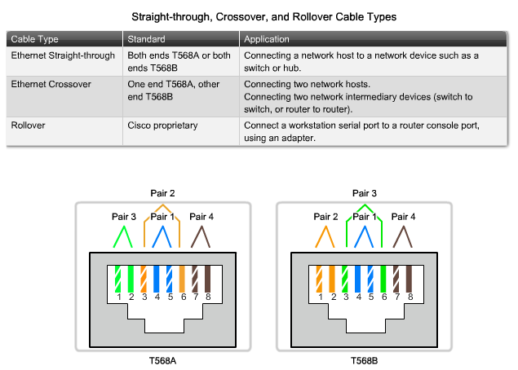
UTP Cable Types

Slide 35
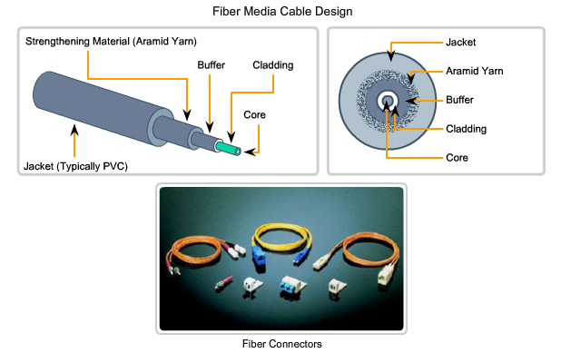
Fiber Media

Slide 36
Fiber Characteristics
Fiber-optic cabling uses either glass or plastic fibers to guide light impulses from source to destination.
The bits are encoded on the fiber as light impulses. Optical fiber cabling is capable of very large raw data bandwidth rates.
Given that the fibers used in fiber-optic media are not electrical conductors, the media is immune to electromagnetic interference and will not conduct unwanted electrical currents due to grounding issues.
Because optical fibers are thin and have relatively low signal loss, they can be operated at much greater lengths than copper media, without the need for signal regeneration.
Some optical fiber Physical layer specifications allow lengths that can reach multiple kilometers.

Slide 37
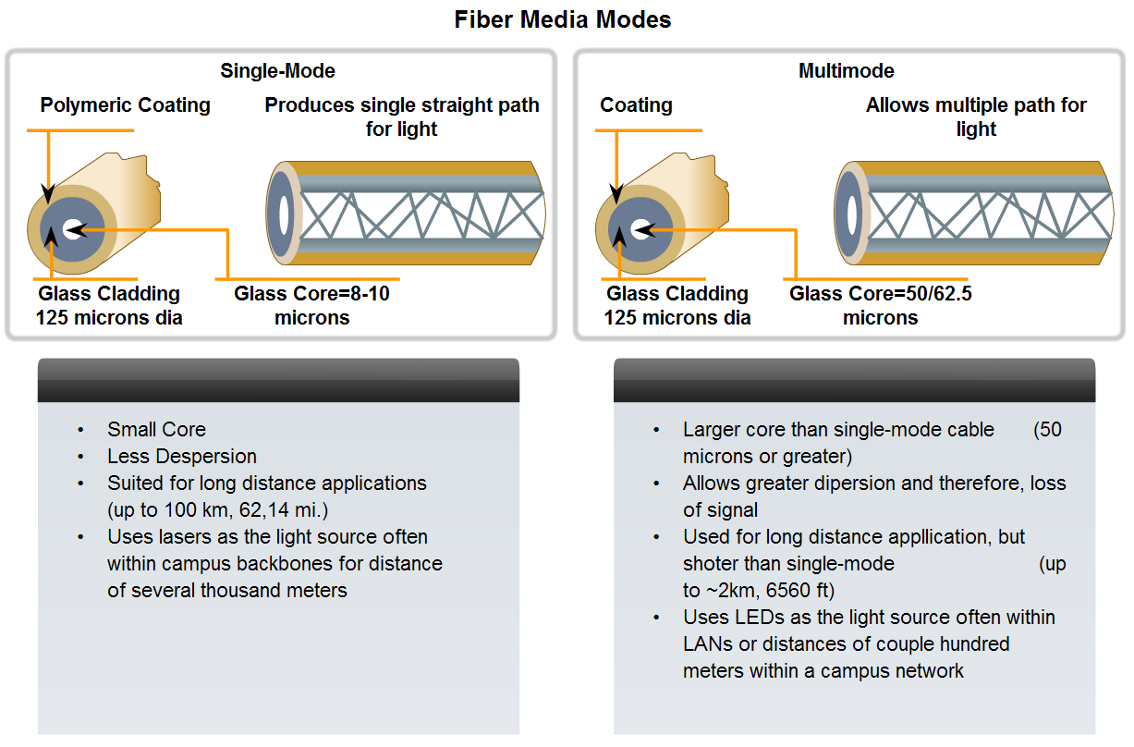
Characteristics & Uses of Network Media
Identify several primary characteristics of fiber cabling and its main advantages over other media

Slide 38
Single vs Multimode
Single-mode optical fiber carries a single ray of light, usually emitted from a laser.
Because the laser light is uni-directional and travels down the center of the fiber, this type of fiber can transmit optical pulses for very long distances.
Multimode fiber typically uses LED emitters that do not create a single coherent light wave.
Instead, light from an LED enters the multimode fiber at different angles.
Because light entering the fiber at different angles takes different amounts of time to travel down the fiber, long fiber runs may result in the pulses becoming blurred on reception at the receiving end.
This effect, known as modal dispersion, limits the length of multimode fiber segments.

Slide 39
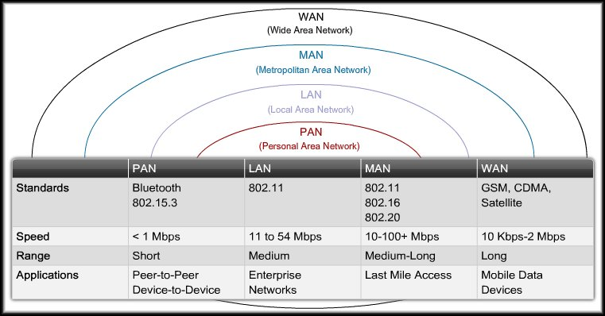
Wireless LANs
Most current business networks rely on switch-based LANs for day-to-day operation inside the office.
Workers are becoming more mobile and want to maintain access to their business LAN resources from locations other than their desks.

Slide 40
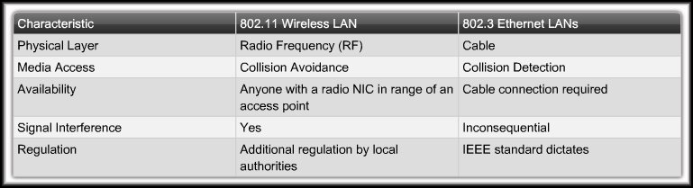
Comparing a WLAN to a LAN
Network Architecture Standards
Physical Media

Slide 41
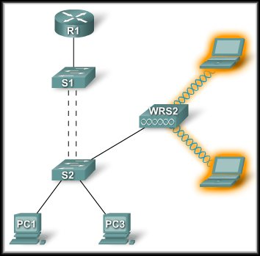
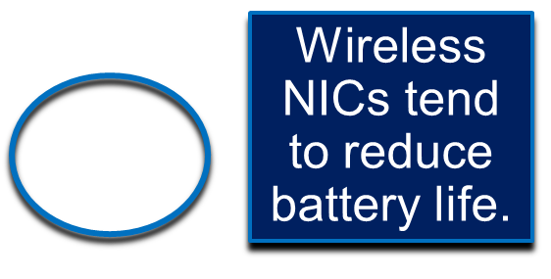
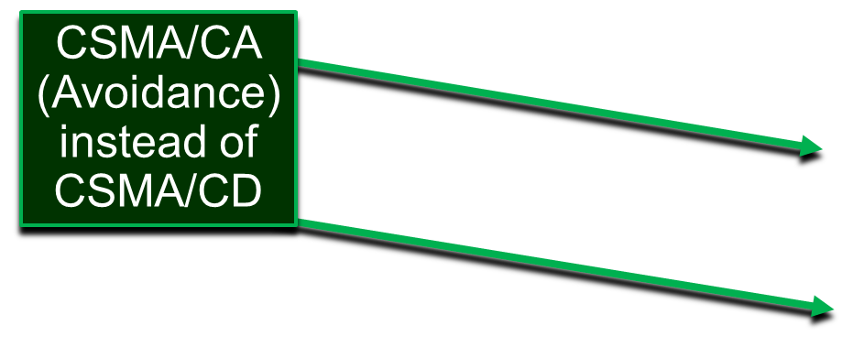
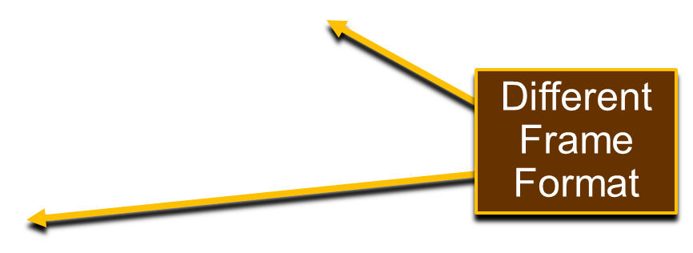
Comparing a WLAN to a LAN
Privacy Issues
Wireless Access Points (AP) instead of a switch.

Slide 42
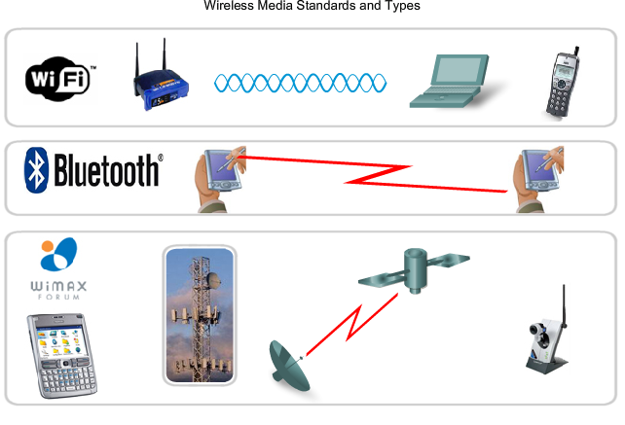
Standards

Slide 43
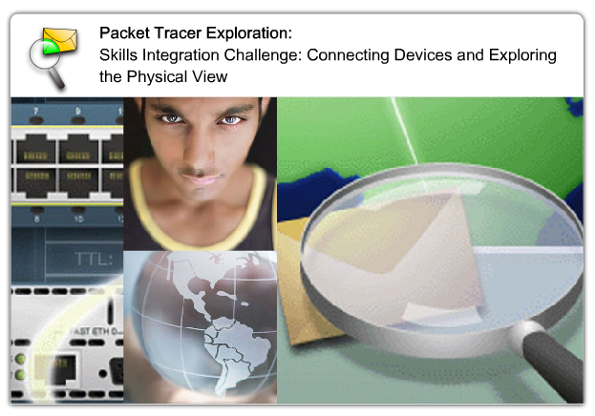
Packet Tracer Lab

Slide 44
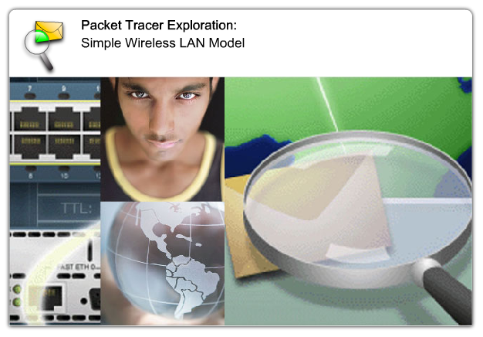
Packet Tracer Lab

Slide 45
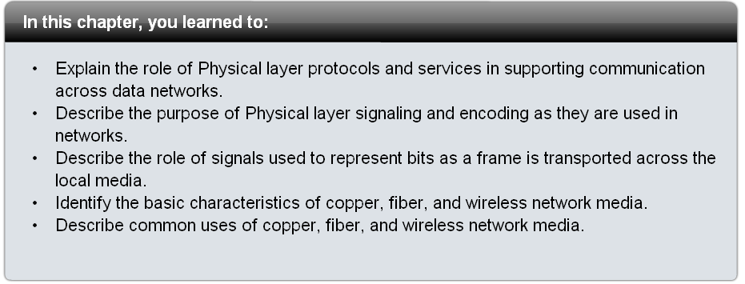
Summary

